Slide 1
Mozart: a music game
胡圣然 曹畅 艾君达
李文博 周文迪
Oct. 10 2019

Slide 2
Part 1: motivation
Given by 胡圣然

Slide 3
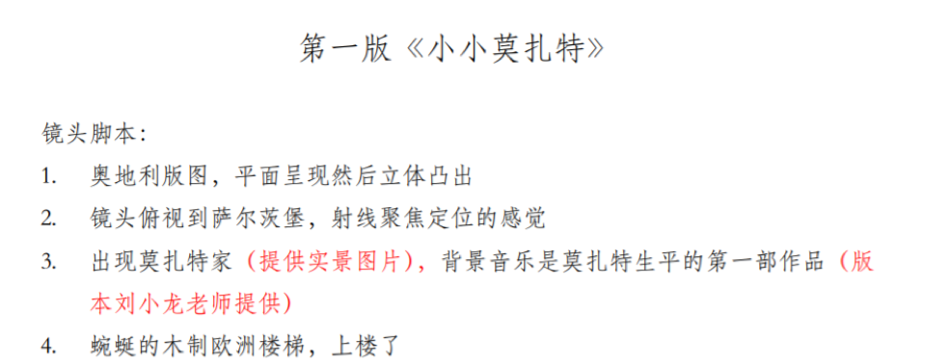
Why we decide to make a music game
The idea of classic music education
A game with fun and knowledge

Slide 4
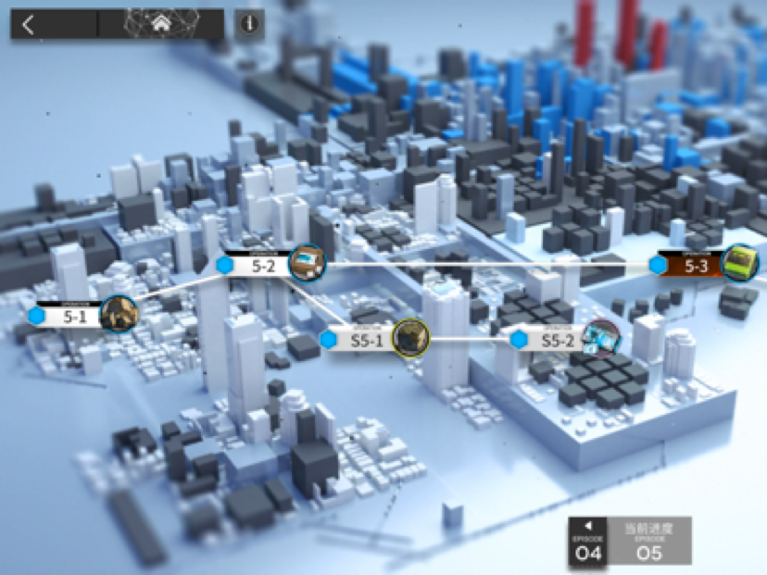
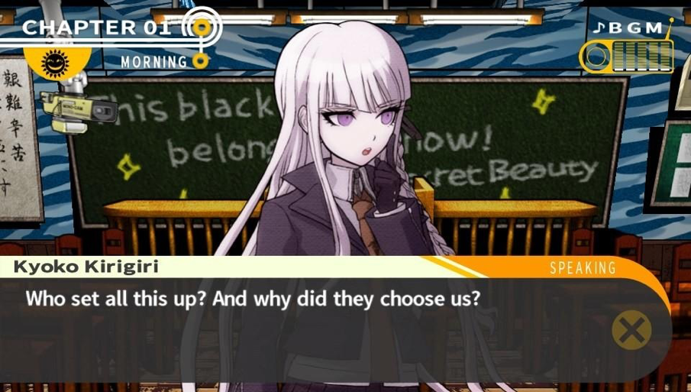
What game is it
A level based game, with Mozart’s life story

Slide 5
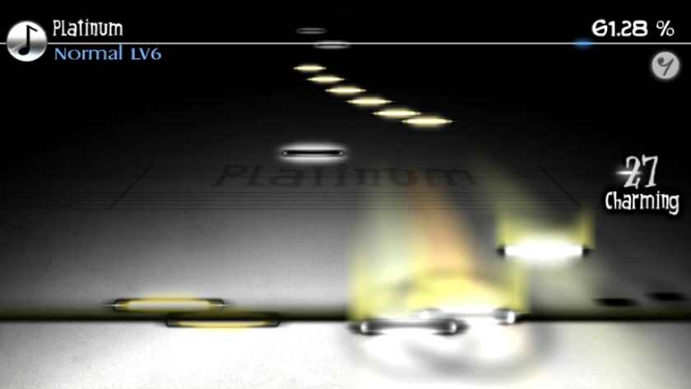
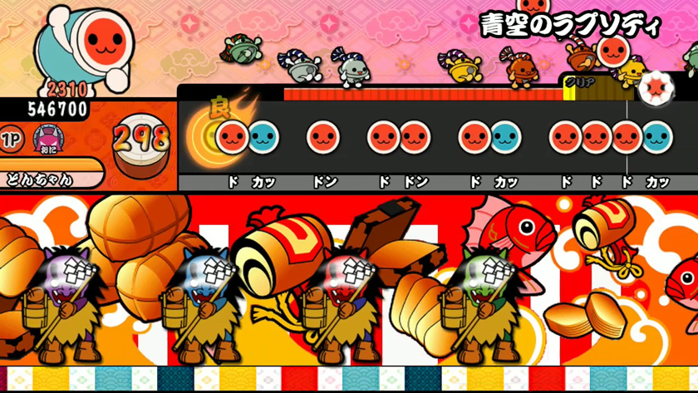
What game is it
Exciting level. Enjoy the fun of music game and classic music

Slide 6
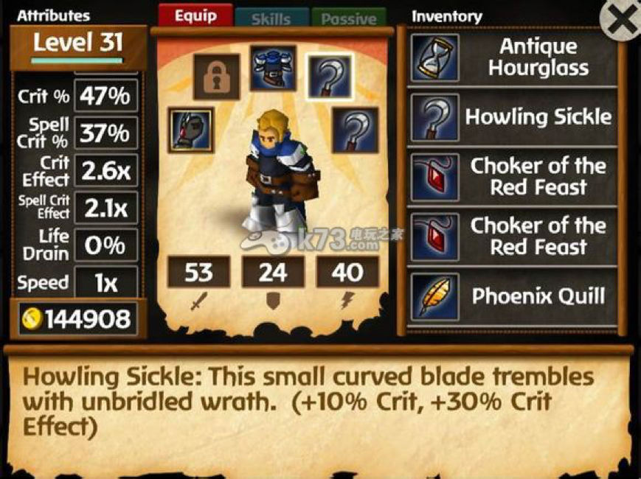
What game is it
RPG

Slide 7
Part 2: Feature description
Given by 曹畅

Slide 8
People of different ages have different cognitions and different demands.
Provide features that meet with variable demands.
All age groups!
4 user stories

Slide 9
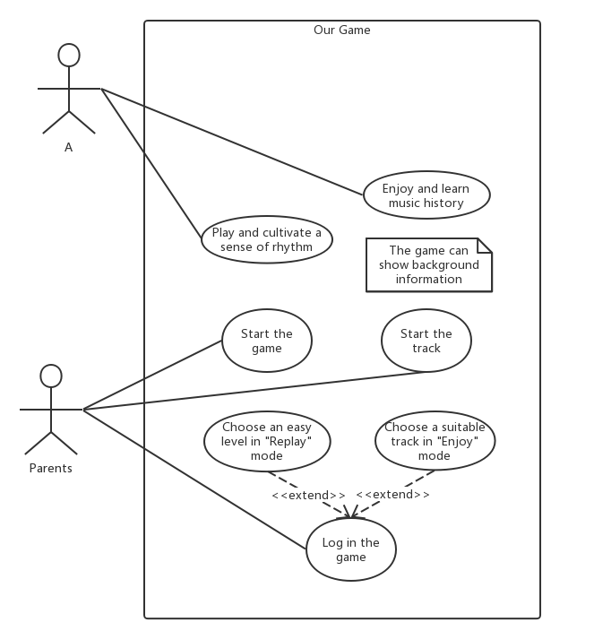
Use case 1
Name: A
Gender: girl
Age: 6
Situation: kindergarten, learn the world
Gain: sense of rhythm, knowledge of classical music

Slide 10
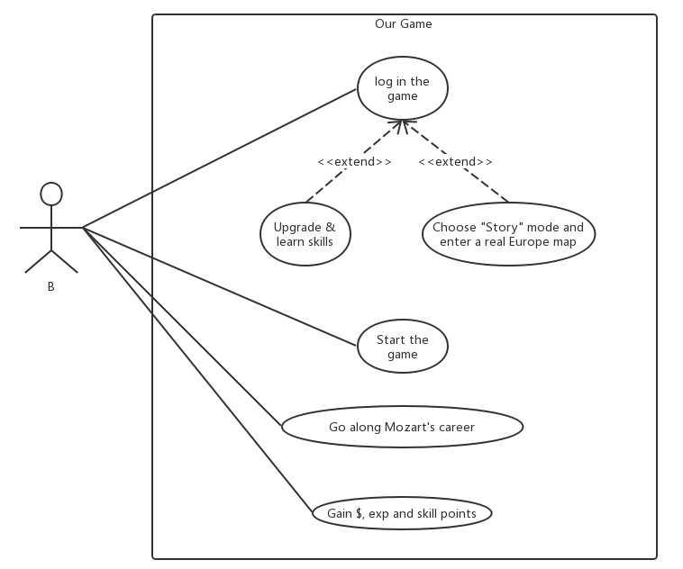
Use case 2
Name: B
Gender: boy
Age: 16
Situation: grade 10 middle school, want to play games in spare time
Gain: interest of classical music, deeper knowledge of Mozart, fun of RPG and development game (养成游戏)

Slide 11
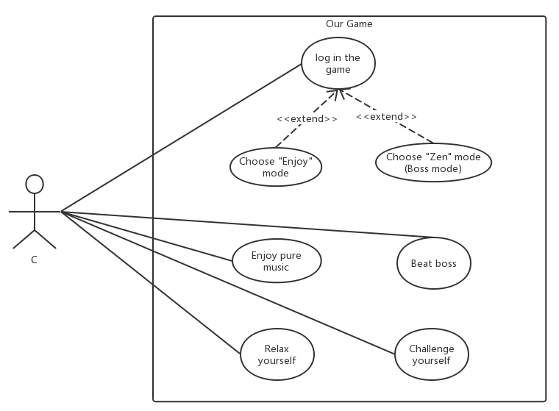
Use case 3
Name: C
Gender: male
Age: 30
Situation: office clerk, heavy workload
Gain: relax, delight of challenge

Slide 12
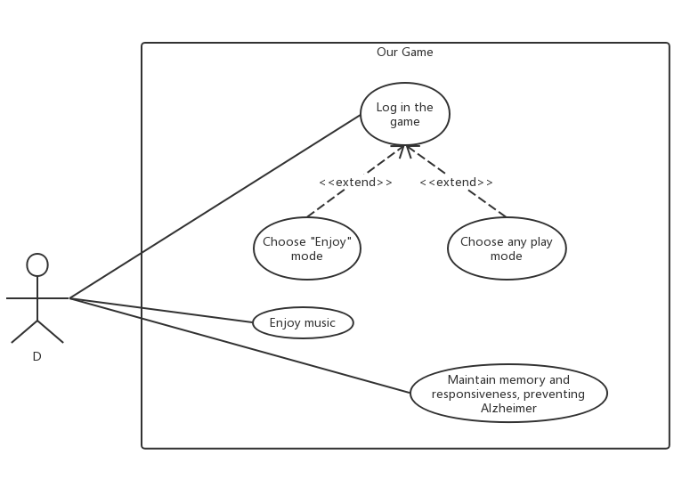
Use case 4
Name: D
Gender: female
Age: 65
Situation: retired, boring, decreased memory and responsiveness
Gain: enjoy music as the elders always do, prevent Alzheimer

Slide 13
Part 3: requirements
Given by 艾君达

Slide 14
Functional Requirements
General Goal: A stand-alone musical game that runs on Windows desktop.
Restraints:
Memory cost
CPU cost
Financial cost
Duration requirement

Slide 15
Functional Requirements
General Goal: A stand-alone musical game that runs on Windows desktop.
Game Modes:
Story mode
Zen mode
Simulation mode

Slide 16
Non-functional Requirements
General Goal: Easy to get on and appeal to people cross age, culture and gender.
Great music collection:
Respecting the historical facts
Highly distinguishable, iconic composes

Slide 17
Non-functional Requirements
General Goal: Easy to get on and appeal to people cross age, culture and gender.
Intuitive, beautiful, smooth UI and UX:
Beautiflul patterns, layout, and font
Instant feedback
Smooth but not too distracting transition animation

Slide 18
Part 4: design document
Given by 李文博

Slide 19
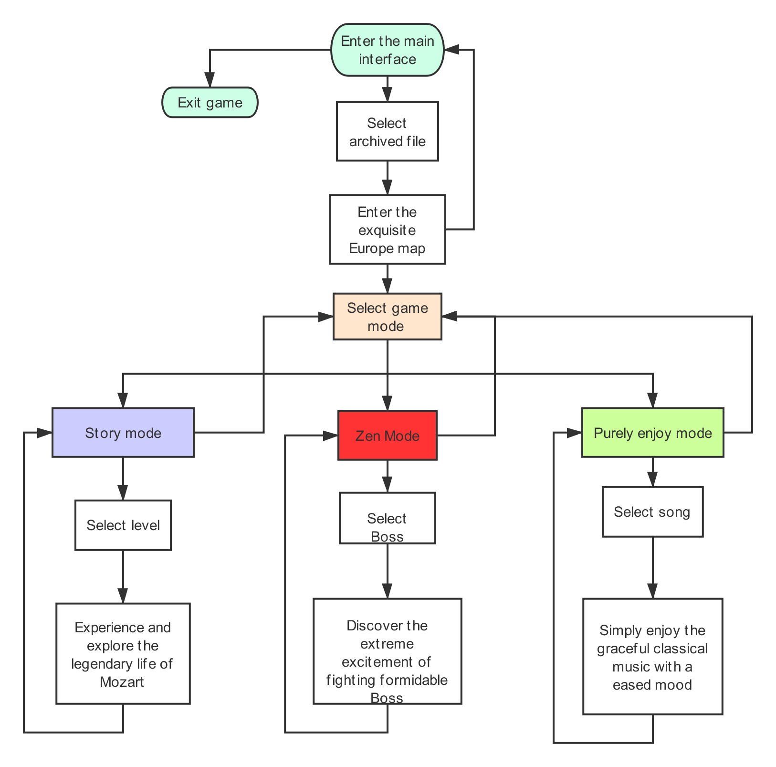
Flow chart

Slide 20
API and Techniques
Game engine: Unity
Map-making, 3-D modeling: MagicaVoxel
UI,Art design: Photoshop, Procreate, Omnigraffle etc.
Database: mySQL
Logic design, Programming: Visual Studio etc.
Music Score design: FL Studio

Slide 21
Part 5: timeline
Given by 周文迪

Slide 22
10.7 Determine the overall schema of the game.
10.13-10.21 Implement the basic functions for a music game.
10.24- 11.8 Rest for about 2 weeks, prepare for mid-term exams.
11.9-11.15 Implement the basic UI-design, implement the function of displaying game story and plot, have a new discussion about the game balance and design.
11.16-11.22 Finish all the basic functions of the game, launch our first runnable demo.

Slide 23
11.23-11.29 Append new game instances, melody, CG, stories and maps.
11.30-12.6 Polish new game instances, melody, CG, stories and maps.
12.6-12.13 Testing, debug, improve user experience etc.
12.13-12.22 Finish off, prepare for our presentation.

Slide 24
Thank You
Coming Soon

